Slide 1
Digital Portfolio
STUDENT NAME: LAVANYA E
REGISTER NO AND NMID: 212401011/7E12D49C7691FCD9488C4B8E7
DEPARTMENT:BCA
COLLEGE: UNIVERSITY OF MADRAS

Slide 2
PROJECT TITLE
DIGITAL PORTFOLIO USING FRONT END
WEB DEVELOPMENT

Slide 3


AGENDA
Problem Statement
Project Overview
End Users
Tools and Technologies
Portfolio design and Layout
Features and Functionality
Results and Screenshots
Conclusion
Github Link
3/21/2024 Annual Review

Slide 4

PROBLEM STATEMENT
In today’s competitive environment, students and professionals struggle to effectively showcase their skills, achievements, and projects using only traditional resumes. A paper-based resume often lacks interactivity, creativity, and the ability to display practical work such as coding projects, designs, or certifications. As a result, recruiters and educators find it difficult to evaluate the true potential of individuals. This creates a gap between academic learning and professional opportunities. To overcome this issue, a digital portfolio provides an effective solution by presenting an individual’s profile, skills, and achievements in an organized, interactive, and visually appealing manner, making it easier for others to assess capabilities and accomplishments.

Slide 5

PROJECT OVERVIEW
The Digital Portfolio project is designed to create an interactive platform for showcasing personal and academic achievements, technical skills, and project work in a professional manner. Unlike traditional resumes, this portfolio provides a visual and organized way to highlight an individual’s strengths, including educational background, certifications, and creative or technical projects. The project uses web technologies such as HTML and CSS to design a clean, user-friendly interface that is both accessible and visually appealing. By integrating sections such as About Me, Skills, Projects, and Contact Information, the portfolio serves as a comprehensive professional profile. This project aims to bridge the gap between academic learning and career opportunities by enabling students and professionals to present themselves effectively in the digital world.

Slide 6

WHO ARE THE END USERS?
The end users of the Digital Portfolio are primarily students who create and manage their profiles, recruiters and employers who review the portfolio for hiring purposes, and educators who evaluate students’ projects and achievements. Additionally, peers and collaborators may also use the portfolio to gain insights into an individual’s skills and contributions.

Slide 7

TOOLS AND TECHNIQUES
The Digital Portfolio project was developed using a combination of tools and web technologies. HTML (Hypertext Markup Language) was used to structure the content of the portfolio, while CSS (Cascading Style Sheets) was applied to enhance the design, layout, and visual appeal. For styling and responsiveness, modern design practices such as color schemes, typography, and grid-based layouts were incorporated. Additionally, tools like text editors (Visual Studio Code / Notepad++) were used for coding, and web browsers (Google Chrome, Microsoft Edge) were utilized for testing and debugging. The techniques applied include responsive web design, ensuring the portfolio is accessible on different devices, and user-friendly navigation, providing a smooth browsing experience for recruiters, teachers, and other viewers.

Slide 8
POTFOLIO DESIGN AND LAYOUT
The design and layout of the Digital Portfolio are created to be simple, professional, and user-friendly. The portfolio is divided into clear sections such as Home, About Me, Skills, Projects, Achievements, and Contact. Each section is neatly arranged to provide quick access to relevant information without overwhelming the viewer. A consistent color scheme and typography are applied throughout the portfolio to maintain visual harmony. The layout follows a grid-based structure, making it clean and organized, while the use of headings, icons, and spacing ensures easy readability. Navigation is provided through a menu bar or sidebar, allowing smooth movement between sections. The design also incorporates responsive techniques, so the portfolio adjusts well on desktops, tablets, and mobile devices. Overall, the layout focuses on simplicity, accessibility, and professional presentation to highlight the individual’s skills and achievements effectively.
8

Slide 9
FEATURES AND FUNCTIONALITY
The Digital Portfolio is designed with essential features and functionalities that make it interactive, professional, and easy to use. It includes an About Me section to introduce the user, highlighting their academic background and career goals. A Skills section lists both technical and soft skills in a structured manner. The Projects section showcases completed academic and personal projects with descriptions, screenshots, or links. The Achievements/Certificates section provides space to display awards, certifications, or extracurricular accomplishments. The Contact section enables recruiters, teachers, or peers to reach out through email or linked profiles such as LinkedIn and GitHub.

Slide 10

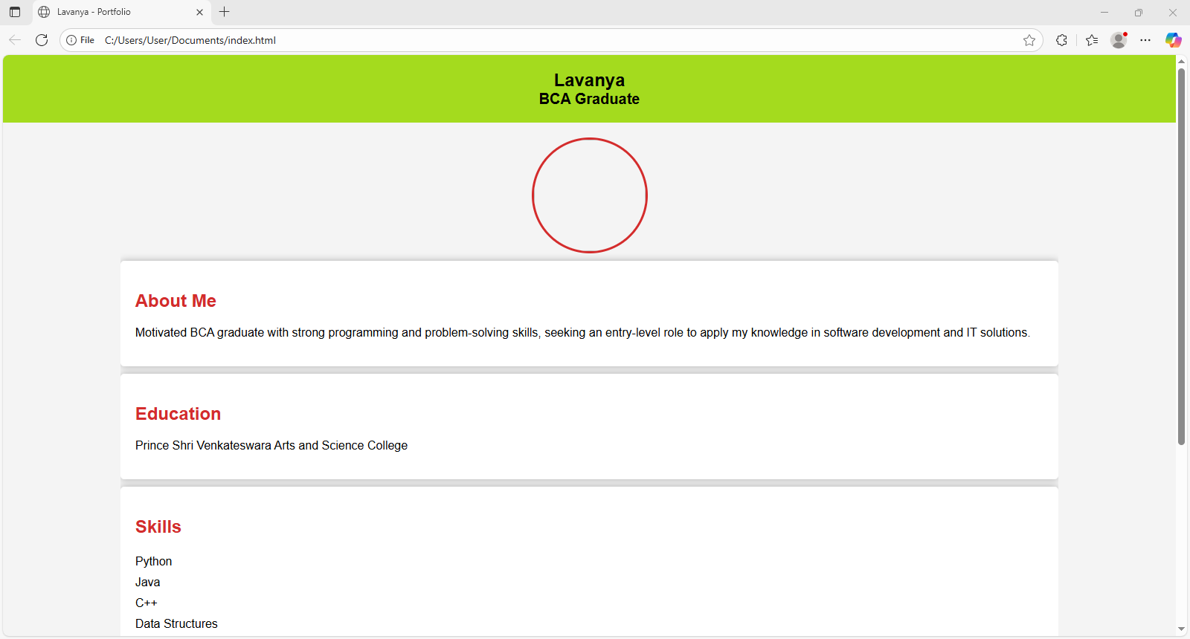
RESULTS AND SCREENSHOTS
The Digital Portfolio project was successfully developed and implemented to provide an effective platform for showcasing personal, academic, and professional details. The portfolio enables users to present their skills, projects, and achievements in a well-structured and visually appealing manner. It ensures easy navigation and responsiveness, allowing access from multiple devices such as desktops, tablets, and mobile phones. The result demonstrates that a digital portfolio is more engaging and interactive compared to traditional resumes, helping students present their talents in a professional way. This enhances opportunities for academic evaluation, internships, and career placements.
3/21/2024 Annual Review
10

Slide 11
CONCLUSION
The Digital Portfolio project demonstrates the importance of using modern technology to present academic and professional information in a more effective and interactive way. Unlike traditional resumes, a digital portfolio provides a dynamic platform where skills, projects, and achievements can be displayed clearly and attractively. This project highlights how web technologies such as HTML and CSS can be used to design a professional, user-friendly, and responsive portfolio that is accessible across different devices. Overall, the Digital Portfolio not only enhances personal branding but also bridges the gap between academic learning and career opportunities by making it easier for recruiters, educators, and peers to evaluate an individual’s capabilities.
11

Slide 12
GITHUB LINK
https://13340bca2024-cmyk.github.io/lavanya/
Notes:
g

